Slide 1

Computer Vision Capabilities for Secure Access Control
Facial Recognition for Enhanced Security
Abhishek Thamatam
tf53379@umbc.edu
+1 3478613400

Slide 2
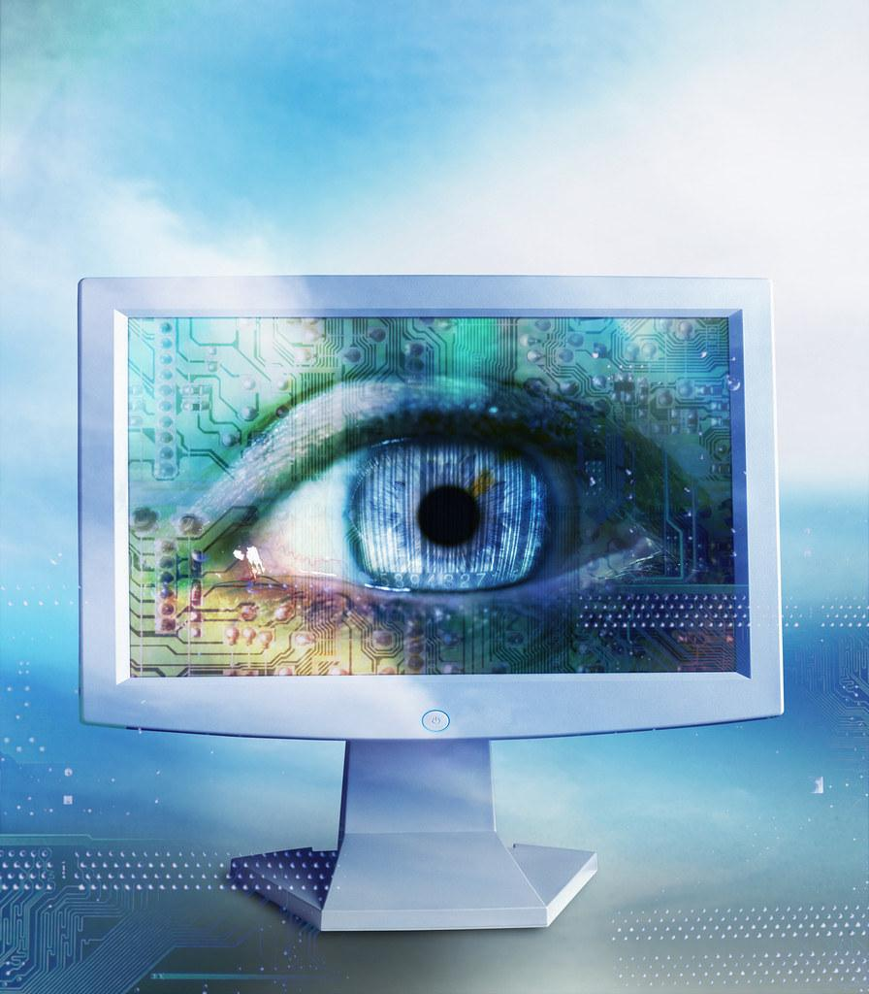

The Importance of Modern AI Computer Vision
Definition of computer vision
Overview of AI advancements in computer vision
Relevance to security and military applications

Slide 3
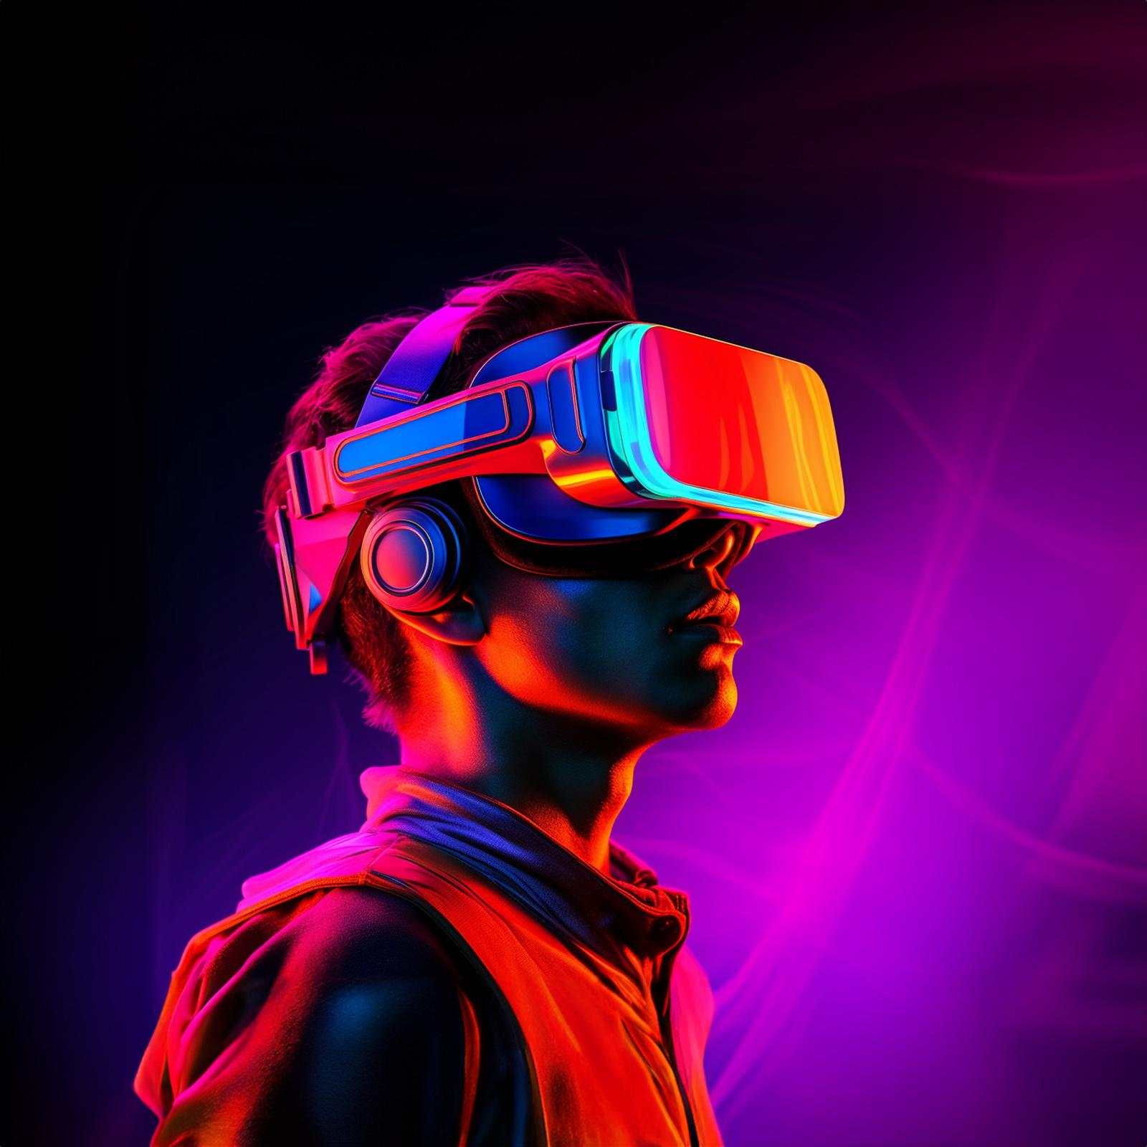
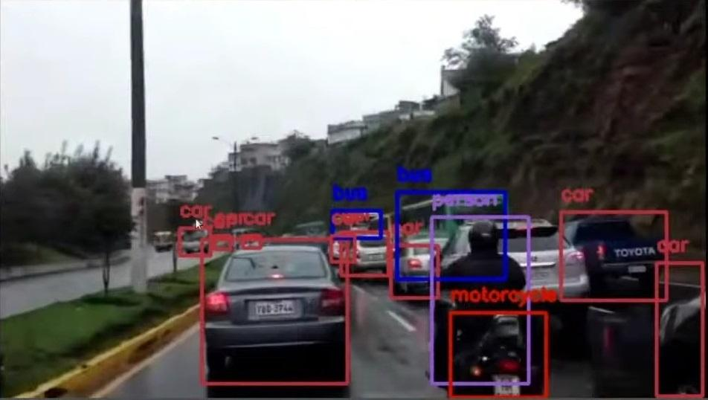

AI in AR/VR Applications
Object detection and avoidance
Image recognition and processing
Use cases in military training and operations

Slide 4


Facial Recognition for Secure Access Control
Project description
Relevance and impact on military security
Technologies used: DeepFace, OpenCV, Dlib, TensorFlow

Slide 5


Technical Approach
Step-by-step process of the facial recognition system
Preprocessing, detection, and recognition
Database creation and access control logic

Slide 6
Implementation
Code snippets and explanations
Visuals of the system in action
Example use case in a military context

Slide 7
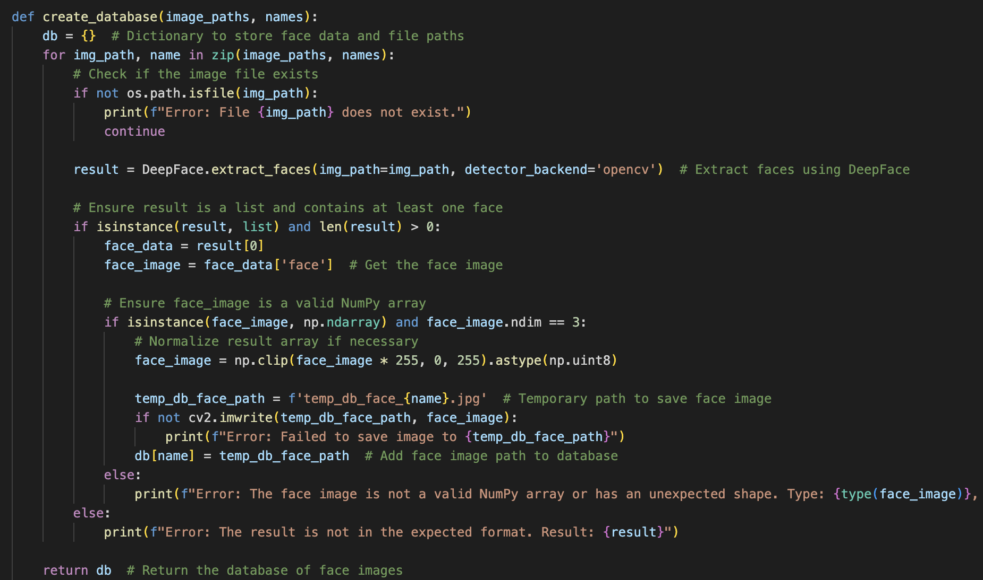
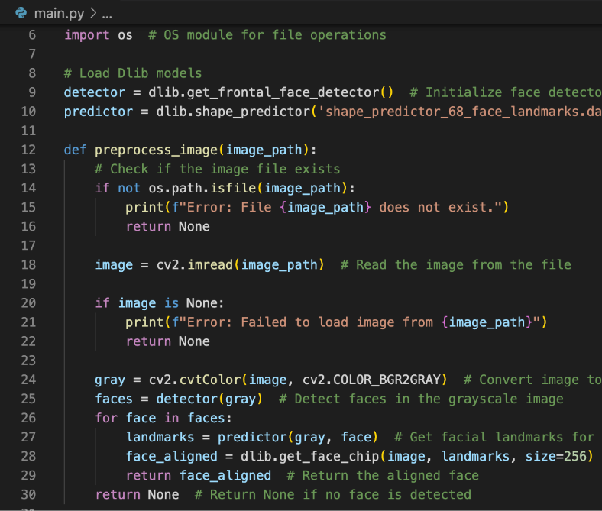

Slide 8
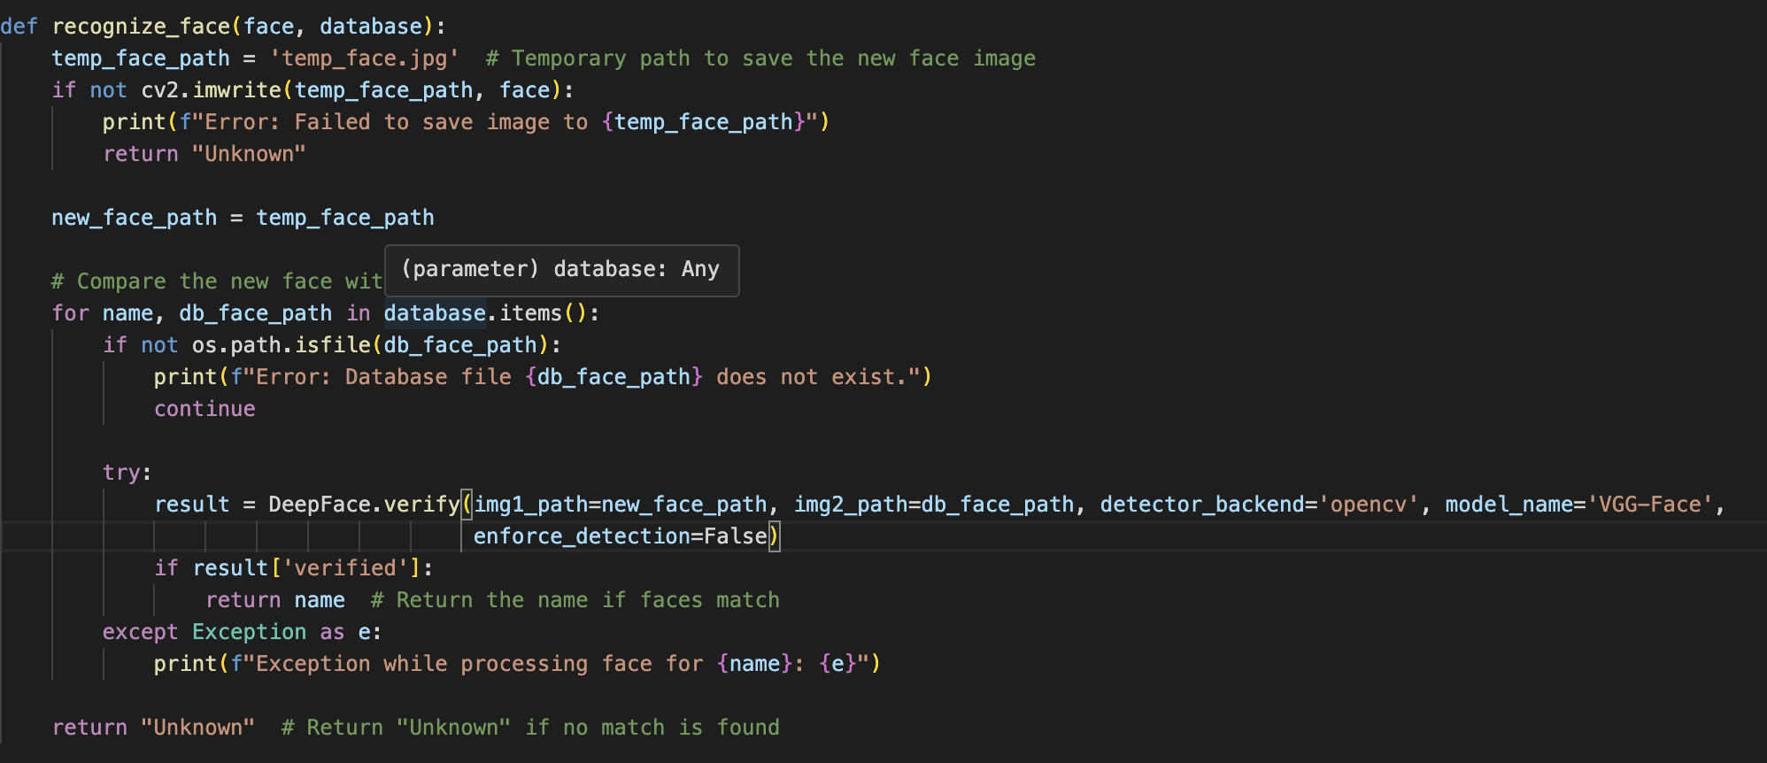
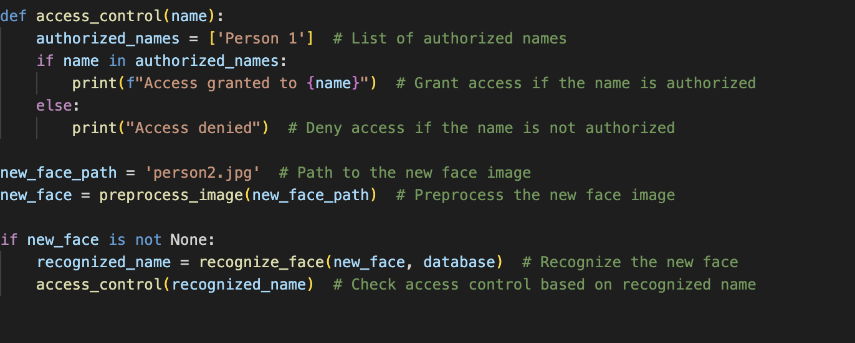

Slide 9
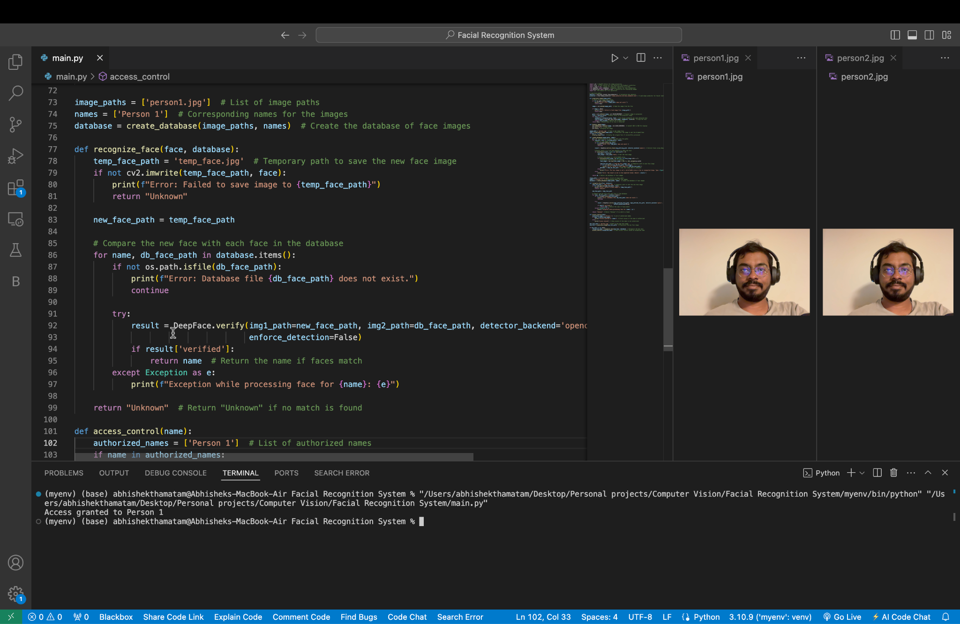
Access Granted Scenario

Slide 10
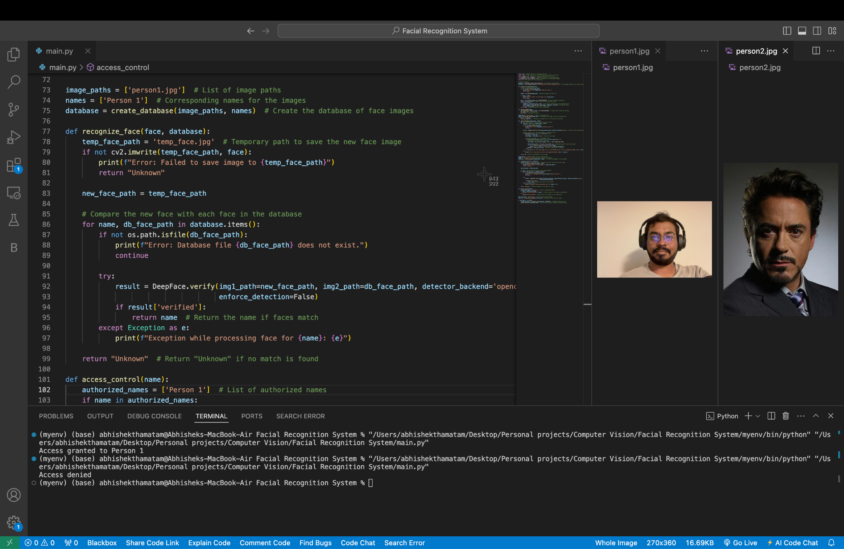
Access Denied Scenario

Slide 11

Results and Performance
Accuracy and efficiency metrics
Testing scenarios and outcomes
Comparison with other methods

Slide 12

Future Enhancements
Potential improvements
Integration with other security systems
Expansion to additional use cases

Slide 13
Conclusion
Summary of capabilities
Impact on military security
Invitation for collaboration

Slide 14
Thank you!

